Slide 1
Attenuator
An attenuator is a passive microwave device used to reduce the power level of a signal without distorting its waveform. It allows precise control over signal strength in microwave systems by providing a known amount of signal attenuation (loss).

Slide 2
Why Use an Attenuator
Attenuators are used for:
1.Protecting sensitive components (like detectors or amplifiers) from high power.
Prevents damage to low -power components from excessive signal power. Especially important in test setups where signal level vary
2. Impedance matching in RF systems to avoid reflections.
Helps maintain a consistent impedance (e.g. 50 ohms) between different devices
Reduces signal reflection and standing waves, improving stability and performance
3. Signal level control for testing and calibration.
Allows precise control of signal amplitude
4. Balancing gain stages in communication and radar systems.

Slide 3
Principle of Operation:
Attenuators work by absorbing part of the signal energy and converting it into heat using resistive elements. The remaining signal continues with reduced power.
Since attenuators do not generate power or amplify the signal, they are classified as passive devices.
How it works
1.Signal input
Ahigh -frequency RF /microwave signal is applied to the input of the attenuator
2.Energy dissipation
Inside the attenuator, resistive elements (or lossy materials in waveguide /microstrip types) absorb apportion of the signal’s energy
This energy is converted into heat, resulting in a reduced signal at the output
3.Impedance matching
The resistive network is carefully designed to maintain impedance matching (usually 50 or 75 ohms) to prevent signal reflection and ensure maximum power transfer.

Slide 4
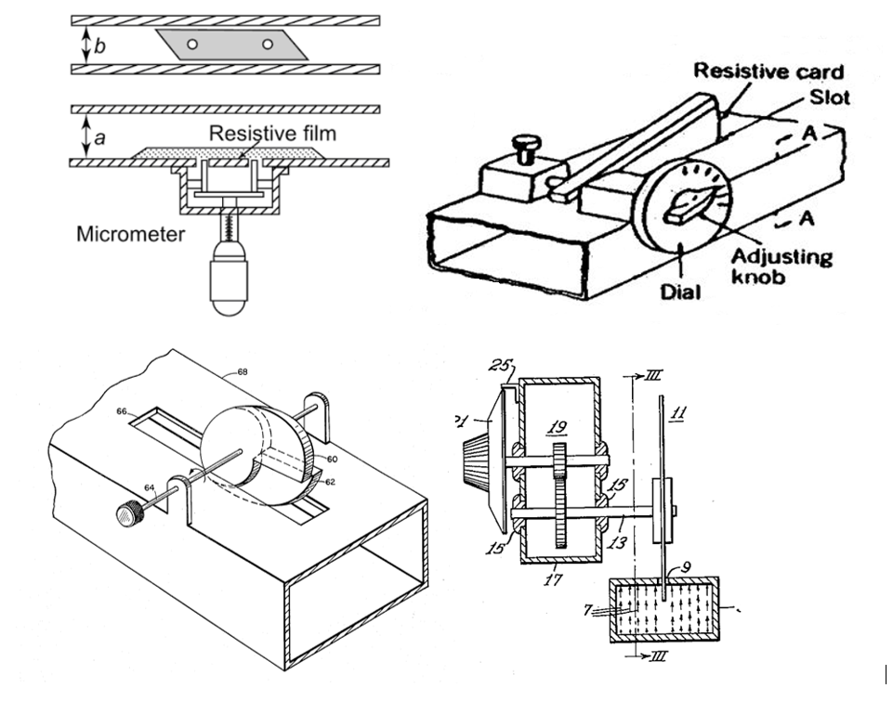
Diagram

Slide 5
4. Types of Attenuators:
a) Fixed Attenuators:
Provide a constant level of attenuation (e.g., 3 dB, 6 dB, 10 dB).
Simple construction using resistors or lossy materials.
b) Variable Attenuators:
Allow manual or electronic adjustment of attenuation level.
Used in tunable systems and test equipment.
c) Step Attenuators:
Allow discrete changes in attenuation using switchable resistor networks.

Slide 6
Microwave Implementation:
Microwave attenuators are implemented in various forms:
1.Coaxial attenuators:
Used in test setups, communication links
Advantage: broadband performance ,easy to connect
2.Waveguide attenuators:
Use resistive cards or vanes placed inside a waveguide.
Advantage : low insertion loss ,high power handling
3.Microstrip or strip line attenuators:
Integrated on a PCB for compact systems.
Advantage : small ,low cost ,easily integrated

Slide 7
Applications:
1.Microwave communication systems
2.Radar transmitters/receivers
3.RF testing and measurements
4. Antenna calibration
6.Satellite systems

Slide 8
Advantages:
1.passive device (no power supply required)
Simple and reliable(no need for external biasing or power)
2.Wide bandwidth
3.Good impedance matching
Helps match impedance between components, minimizing reflections and standing waves
4.Ease of use in testing
Essential in RF test setups to protect instruments and adjust signal levels.
Disadvantage
1.fixed attenuators lack flexibility
2.limited attenuation range (for single units)
3.size and cost
Some types are bulky or costly

Slide 9
Conclusion:
Attenuators are essential passive devices in microwave engineering, ensuring safe, efficient, and controlled signal transmission in high-frequency systems. Their ability to manage signal levels makes them invaluable in both lab testing and real-world RF applications.

